Slide 1
Bahir Dar University
MSc. In computer science
Chapter 1: Overview of machine learning
Notes:
To solve a problem on a computer, we need an algorithm. An algorithm is a sequence of instructions that should be carried out to transform the input to output. For example, one can devise an algorithm for sorting. The input is a set of numbers and the output is their ordered list. For the same task, there may be various algorithms and we may be interested in finding the most efficient one, requiring the least number of instructions or memory or both.
For some tasks, however, we do not have an algorithm—for example, to tell/identify spam emails from legitimate emails. We know what the input is: an email document that in the simplest case is a file of characters. We know what the output should be: a yes/no output indicating whether the message is spam or not. We do not know how to transform the input to the output. What can be considered spam changes in time and from individual to individual.
For example, of a supermarket chain that has hundreds of stores all over a country selling thousands of goods to millions of customers. We do not know exactly which people are likely to buy this ice cream flavor, or the next book of this author, or see this new movie, or visit this city, or click this link. If we knew, we would not need any analysis of the data; we would just go ahead and write down the code.
But because we do not, we can only collect data and hope to extract the answers to these and similar questions from data.

Slide 2
What is machine learning ?
Many definitions have been proposed for the term machine learning (ML).
Machine learning is a branch of artificial intelligence, concerned with the design and development of algorithms that allow computers to evolve behaviours based on empirical data.
Arthur Samuel (1959) defined machine learning as “a subfield of computer science that gives computers the ability to learn without being explicitly programmed.”
  It means that ML is able to perform a specified task without being directly told how to do it.
  Example: distinguish between spam and valid email messages. Given a set of manually labelled good and bad email examples, an algorithm can automatically learn a set of rules that distinguish them.
Notes:
AI is simply the ability of machines to simulate human intelligence, with minimal human interventions. I.e. it is the science and engineering of making intelligent machines, especially intelligent computer programs.
ML is a broad and rapidly growing area of research in the field of artificial intelligence.
The definition of what exactly constitutes machine learning has been varied among the different experts in the field.

Slide 3
What is machine learning ?
A widely accepted formal definition by Tom Mitchell (1997)
  A computer program is said to learn from experience E with respect to some class of tasks T and performance measure P, if its performance at the tasks T , as measured by P, improves with the experiences.
In short
  a set of computer programs that automatically learn from past experiences (examples or training corpus)
  Improve the performances of intelligent programs
Example: According to this definition, we can reformulate the email problem as the task of identifying spam messages (task T) using the data of previously labelled email messages (experience E) through a machine learning algorithm with the goal of improving the future email spam labelling (measure P)
Notes:
ML is a broad and rapidly growing area of research in the field of artificial intelligence.
The definition of what exactly constitutes machine learning has been varied among the different experts in the field.

Slide 4
What is machine learning ?
A widely accepted formal definition by Tom Mitchell (1997)
  A computer program is said to learn from experience E with respect to some class of tasks T and performance measure P, if its performance at the tasks T , as measured by P, improves with the experiences.
Example: Handwritten recognition problem
  Task T : Recognizing hand written characters
  Performance measure P : Percent of characters correctly classified
  Training experience E: A database of handwritten characters with given classifications
Notes:
ML is a broad and rapidly growing area of research in the field of artificial intelligence.
The definition of what exactly constitutes machine learning has been varied among the different experts in the field.

Slide 5
What is machine learning ?
In the field of today’s data science:
ML aims to select, explore and extract useful knowledge from complex, often non-linear data, building a computational model capable of describing unknown patterns or correlations, and in turn, solve challenging problems.
This learning process is often carried out through repeated exposure to the defined problem (dataset), allowing the model to achieve self-optimization and continuously enhance its ability to solve new, previously unseen problems.
Notes:
The main outcome of machine learning is a measure (proxy) of generalizability: the extent to which the model is capable of outputting
correct predictions when presented with new data, based on learned rules from previous exposure to similar (but not the same) data.
Application of machine learning methods to large databases is called data mining.

Slide 6
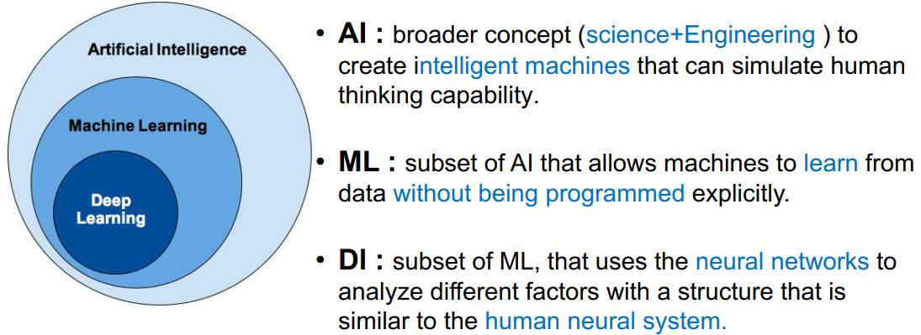
Artitificial intelligence Vs. Machine Learning Vs. Deep learning

Slide 7
Probability Theory in Machine Learning
Probability is key concept is dealing with uncertainty
Three main sources of uncertainty in machine learning: noisy data, incomplete coverage of the problem domain and imperfect models.
Probability Theory
  Framework for quantification and manipulation of uncertainty
  Provides the foundation and tools for quantifying, handling, and harnessing uncertainty in applied machine learning.
Probability provides the basis for developing specific algorithms, such as Naive Bayes, and Bayesian Belief Networks
Notes:
Uncertainty refers to imperfect or incomplete information. Probability theory is the mathematics of uncertainty.
Noisy data: referes to variability or an error in the data . Incomplete Coverage of the Domain: Observations from a domain used to train a model are a sample and incomplete by definition. Imperfect Model of the Problem: All models are wrong but some are useful.
In terms of noisy observations, probability and statistics help us to understand and quantify the expected value and variability of variables in our observations from the domain.
In terms of the incomplete coverage of the domain, probability helps to understand and quantify the expected distribution and density of observations in the domain.
In terms of model error, probability helps to understand and quantify the expected capability and variance in performance of our predictive models when applied to new data.
Probability provides the foundation for the iterative training of many machine learning models, called maximum likelihood estimation, behind models such as linear regression, logistic regression, artificial neural networks, and much more.
Probability also provides the basis for developing specific algorithms, such as Naive Bayes, as well as entire subfields of study in machine learning, such as graphical models like the Bayesian Belief Network

Slide 8
Basic Concepts on Probability
Probability. The word probability is actually undefined, but the probability of an event can be explained as the proportion of times, under identical circumstances, that the event can be expected to occur.
  It is the event's long-run frequency of occurrence.
  For example, the probability of getting a head on a coin toss = .5. If you tossing a coin repeatedly, for a long time, you will note that a head occurs about one half of the time.
Probability vs. Statistics.
  In probability, the population is known.
  In statistics you draw inferences about
  the population from the sample.
Probability
Population
Sample
Statistics
Notes:
Why Learn Probability for Machine Learning
Class Membership Requires Predicting a Probability
Some Algorithms Are Designed Using Probability
Models Are Trained Using a Probabilistic Frame-work
Models Can Be Tuned With a Probabilistic Frame-work

Slide 9
Probabilistic vs Statistical Reasoning
Suppose I know exactly the proportions of car makes in California. Then I can find the probability that the first car I see in the street is a Ford. This is probabilistic reasoning as I know the population and predict the sample.
Now suppose that I do not know the proportions of car makes in California, but would like to estimate them. I observe a random sample of cars in the street and then I have an estimate of the proportions of the population. This is statistical reasoning

Slide 10
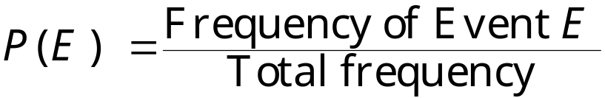
Key Terms
Classical (or theoretical) probability is used when each outcome in a sample space is equally likely to occur. With theoretical probability, we do not actually conduct an experiment. The classical probability for event E is given by
Toss a coin and the probability of getting a head or a tail is 1/2. P(head) =1/2, P(tail) = ½
Example 1: Find the probability of rolling a 6 on a fair die. Answer: The sample space for rolling is die is 6 equally likely results: {1, 2, 3, 4, 5, 6}. The probability of rolling a 6 is 1/6.
If you roll a fair die, what is the probability of rolling an even number?
Empirical (or statistical) probability, also called experimental probability, is based on observations obtained from probability experiments. Empirical probability is found by repeating an experiment and observing the outcomes. Each observation in an experiment is called a trial.The empirical frequency of an event E is the relative frequency of event E.
Notes:
Theoretical probability is what is expected to happen.
Experimental probability is the result of an experiment, i.e., what actually happens when we try it out.
P(even)=P(2,4,6)=3/6=1/2

Slide 11
Key Terms
Examples of emperical probability
You tossed a coin 10 times and recorded a head 3 times, a tail 7 times. P(head)= 3/10, P(tail) = 7/10
A survey was conducted to determine students' favourite brands of sneakers. Each student chose only one brand from the list of brands A (12), B(15), C(24), D(26), or E(13). What is the probability that a student's favourite sneaker was brand D? Answer: There were 12 + 15 + 24 + 26 + 13 = 90 "trials" in this experiment (each student's response was a trial). 26 out of the 90 students chose brand D. The probability is : 26/90=13/45
Simple probability. P(A). The probability that an event (say, A) will occur.
Joint probability. P(A and B). P(A ∩ B). The probability of events A and B occurring together.
Conditional probability. P(A|B), read "the probability of A given B." The probability that event A will occur given event B has occurred.

Slide 12
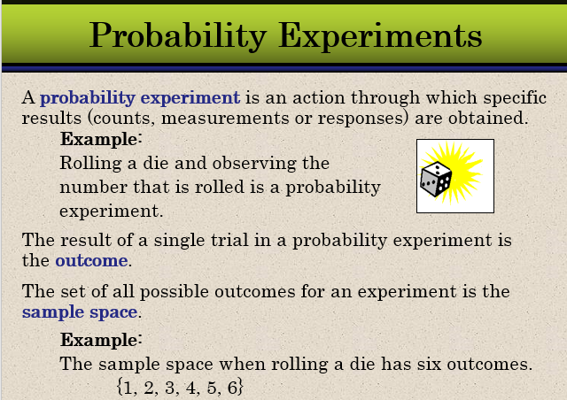

Slide 13
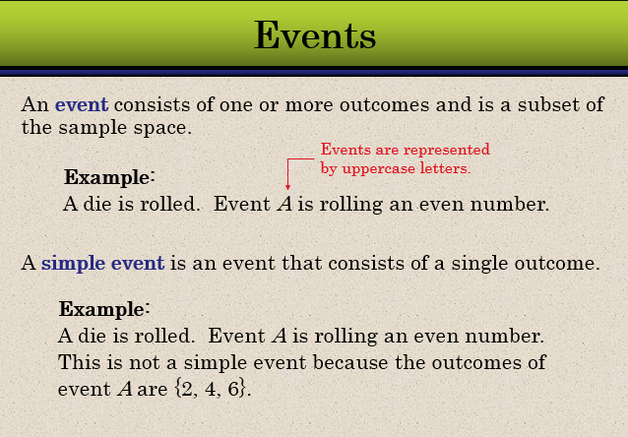

Slide 14
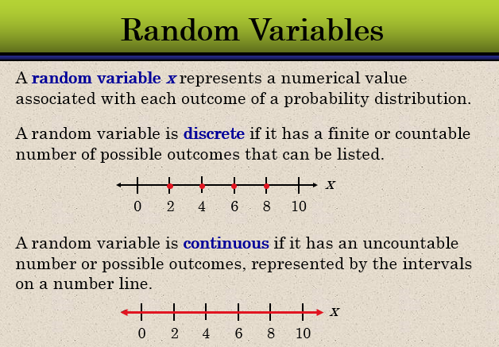

Slide 15
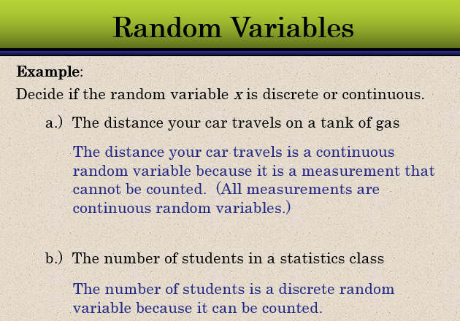

Slide 16
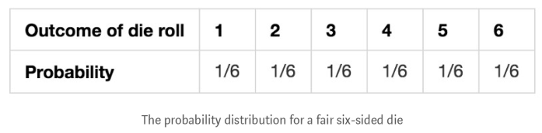
Probability Distributions
Probability distribution is a list of all possible outcomes of a random variable along with their associated probability values.
Example 1: the probability distrubtion of a fair 6-sided die.
Example 2: What is probability distribution for the number of heads occurring in three coin tosses?
Notes:
X(outcome): 0,1,2,3 (ttt, htt,tht,tth,thh,hht,hth,hht, thh,hhh)
Probability (P(X)): 1/8,3/8,3/8,1/8

Slide 17
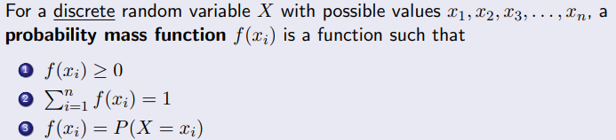
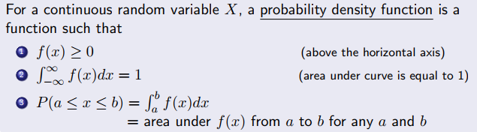
Probability Distributions
A function that represents a discrete probability distribution is called a probability mass function (PMF).
A function that represents a continuous probability distribution is called a probability density function (PDF).

Slide 18
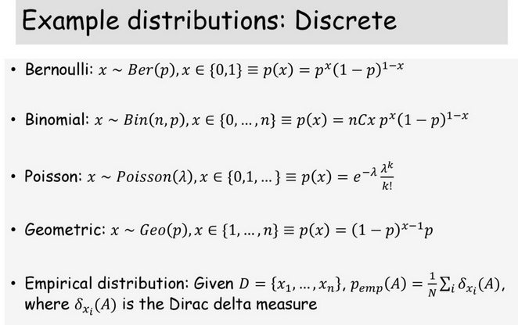

Slide 19
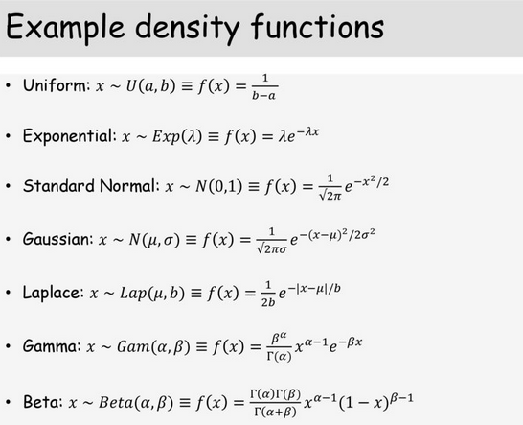

Slide 20
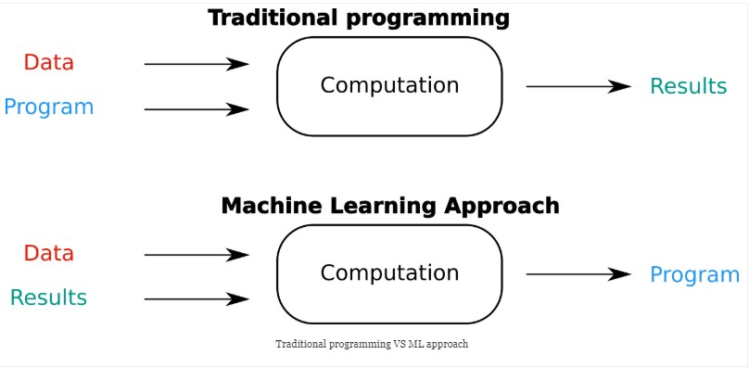
Traditional vs ML Approach
Notes:
Traditional programming is a manual process—meaning a person creates the program (i.e. you should write codes from A to Z), and the computer does what you say.
Creating programs/Designing rules requires a deep understanding of how a decision should be made by a human expert. However, handcoded approach will fail is in detecting faces in images.
Machine learning is trained rather than explicitly programmed. The algorithm automatically formulates the rules from the data /learns by itself.
For instance, if you want to predict who will pay the bills late, identify the input (customer demographics, bills) and the output (pay late or not), and let the machine learning use this data to create your model (i.e. a program).
Presenting a program with a large collection of images of faces is enough for an ML algorithm to determine what characteristics are needed to identify a face .

Slide 21
Related Fields
data
mining
Optimization
statistics
machine
learning
decision theory
information theory
cognitive science
databases
psychological models
evolutionary
models
neuroscience
Machine learning is primarily concerned with the accuracy and
effectiveness of the computer system in performing complex tasks.
Notes:
ML draws on concepts from many different fields, including computer science, statistics, and optimization. At their core, almost all ML problems can be formulated as an optimization problem with respect to a dataset. In such settings, the goal is to find a model that best explains the data. Often, ML is related to pattern recognition, artificial intelligence, data mining, and statistics.

Slide 22
Statistics vs. Machine Learning
Statistics | Machine Learning
Inference | Prediction
Small data sets/low-dimensional data | Large data sets/high-dimensional data
Specific assumptions and hypotheses | Large flexibility and free from a priori assumptions/hypothesis free
Computation of the P values to accept or reject a null hypothesis | ROC curve, cross-validation, etc.
Fitting a parsimonious model to produce an easy to understand and interpretable results | Considers complex non-linear patterns, a sophisticated model that is not easy to understand or interpret.
Notes:
Inference: drawing conclusions about something in the text using the text evidence, your own background knowledge and common sense. Inferences are made about what happened in the past or what is currently happening. Prediction: using the text evidence, background knowledge and common sense to make a guess to what will happen in the future. Predictions are an attempt to guess what will happen in the future.
Inference creates a mathematical model of the data generation process to formalize understanding or test a hypothesis about how the system behaves. Prediction aims at forecasting unobserved outcomes or future behaviour that makes it possible to identify best courses of action (e.g., treatment choice) without requiring understanding of the underlying mechanisms. In a typical research project, both inference and prediction can be of value—we want to know how biological processes work and what will happen next.
Data-mining: Using very simple machine learning techniques on very large databases because computers are too slow to do anything more interesting with ten billion examples.

Slide 23
Classes of Machine Learning problem
Supervised Learning
  Learn to predict output when given an input vector
  Training data includes desired outputs
Unsupervised Learning
  The aim is to uncover the underlying structures (classes or clusters) in the data
  Training data does not include desired outputs. This is the new frontier of machine learning because most big datasets do not come with labels.
Semi-supervised Learning
  Desired outputs or classes are available for only a part of the training data.
  This approach is useful when it is impractical or too expensive to access or measure the target variable for all participants
Reinforcement Learning
  Learning method that interacts with its environment by producing actions and discovers errors or rewards.
  On the basis of trial and error, to discover what actions maximize reward and minimize the penalty.
Notes:
Input data has known labels

Slide 24
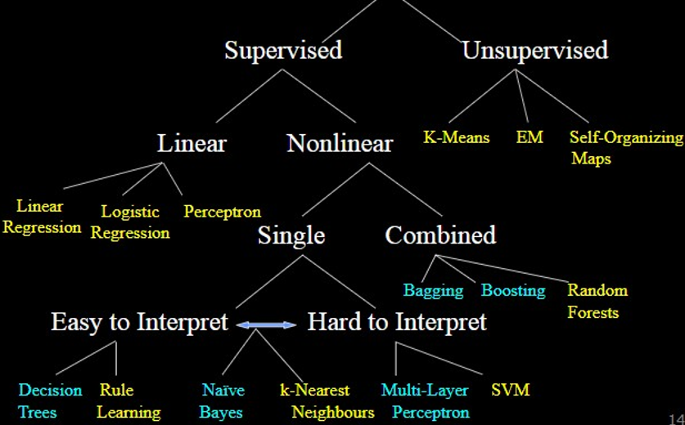
Classes of machine learning problem

Slide 25
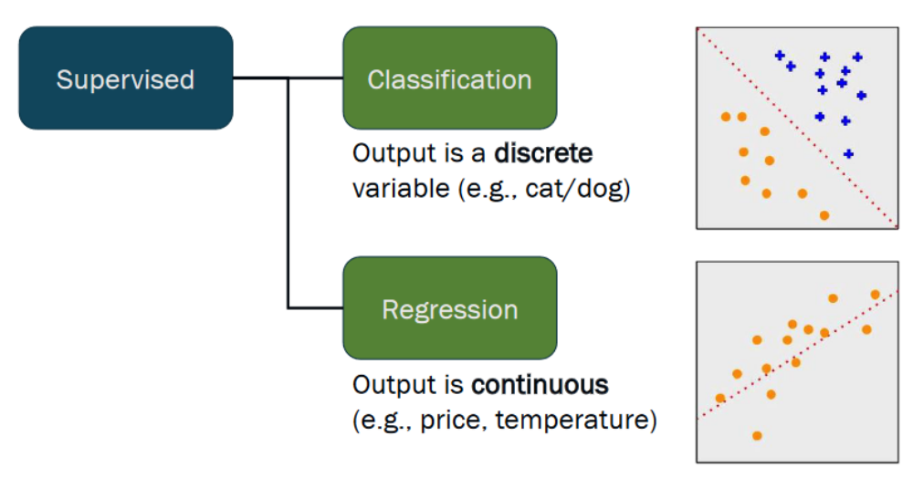
Classes of machine learning Problem
Notes:
Learn through examples of which we know the desired output (what we want to predict).
Is this a cat or a dog? Are these emails spam or not?
Predict the market value of houses, given the square meters, number of rooms, neighborhood, etc.

Slide 26
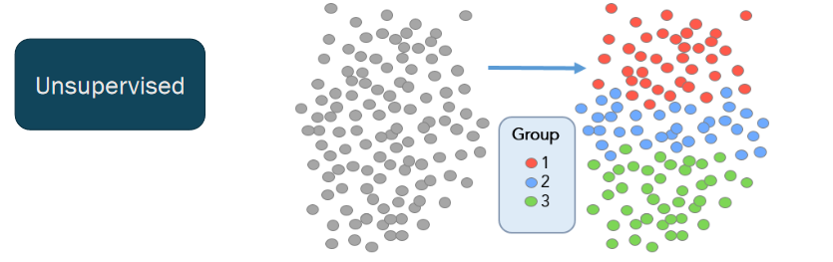
Classes of machine learning Problem
Clustering
Dimensionality reduction
Notes:
There is no desired output. Learn something about the data. Latent relationships.
I have photos and want to put them in 20 groups. I want to find anomalies in the credit card usage patterns of my customers.
Segmenting customers into groups with similar preferences.

Slide 27
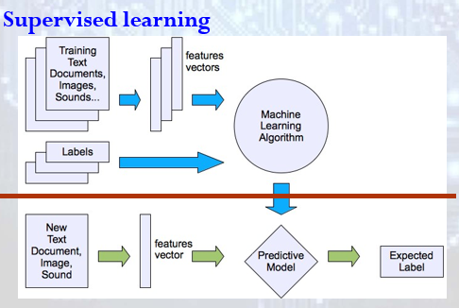
Machine learning structure

Slide 28
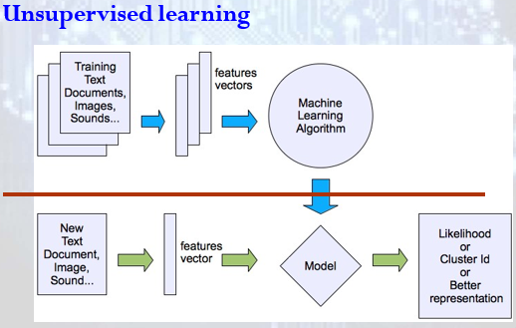
Machine learning structure

Slide 29
The Learning Problem
Given <x,f(x)> pairs, infer f
x | f(x)
1 | 1
2 | 4
3 | 9
4 | 16
5 | ?
Given a finite sample, it is often
impossible to guess the true function f.
Approach: Find some pattern (called a hypothesis) in the training examples, and assume that the pattern will hold for future examples too.

Slide 30
The machine learning framework
y = f(x)
Training: given a training set of labeled examples {(x₁,y₁), …, (x_{N},y_{N})}, estimate the prediction function f by minimizing the prediction error on the training set
Testing: apply f to a never before seen test example x and output the predicted value y = f(x)
output
prediction function
Image feature
Slide credit: L. Lazebnik

Slide 31
Learning—A Two-Step Process
Model construction:
  A training set is used to create the model.
  The model is represented as classification rules, decision trees, or mathematical formulae
Model usage:
  the test set is used to see how well it works for classifying future or unknown objects

Slide 32



Step 1: Model Construction
Classification
Algorithms
Training
Data
Classifier
(Model)
IF rank = ‘professor’
OR years > 6
THEN tenured = ‘yes’

Slide 33




Step 2: Using the Model in Prediction
Classifier
model
Testing
Data
Unseen Data
(Jeff, Professor, 4)
Tenured?

Slide 34
Applications of Machine learning
Prediction (weather, medical, agricultural yield, etc.)
Face detection; character recognition;
Surveillance and security system
Object detection and recognition
Natural language processing (word sequence predication, spelling and grammar checker, speech recognition (dialog system),translation system, information retrieval, news text classification)
Image segmentation
Multimedia event detection
Economical and commercial usage
Outlier detection: Exceptions that are not covered by the rule, e.g., fraud
……… many many more

Slide 35
Challenges in Machine Learning
Efficiency and scalability of machine learning algorithms
Handling high-dimensionality
Handling noise, incomplete and imbalanced data
Pattern evaluation and knowledge integration
Protection of security, integrity, and privacy in machine learning
Data acquisition and representation issues
Degree of interpretability for predictive power
Deployment issues
Notes:
Scalability: refers to the ability to construct the classifier or predictor efficiently given large amounts of data.
There is no standard for security, privacy and deployment of machine learning models

Slide 36
Basic Steps in Machine Learning
Data collection
  “training data”, mostly with “labels” provided by a “teacher”;
Data preprocesing
  Clean data to have homogenity
Feature engineering
  Select represenatative features to improve performance
Modeling
  choose the class of models that can describe the data
Estimation/Selection
  find the model that best explains the data: simple and fits well;
Validation
  evaluate the learned model and compare to solution found using other model classes;
Operation
  Apply learned model to new “test” data or real world instances

